Slide 1




Managing power bi dataset refresh failures
Craig Porteous
@cporteous CraigPorteous.com github.com/cporteou
Paul Broadwith @pauby

Slide 2
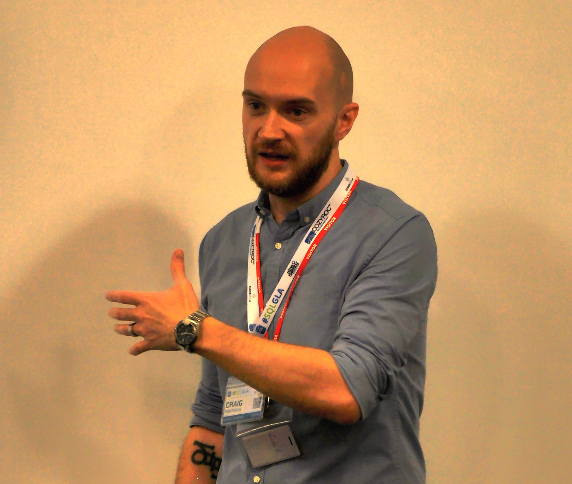


About me
Craig Porteous
Business Intelligence Admin/Developer
Worked with SQL for 10 years. Started using PowerShell 3 years ago
Write for SQLShack & Co-lead the SQL Glasgow UG
Contact Me
https://CraigPorteous.com
@cporteous
https://github.com/cporteou
https://www.linkedin.com/in/craigporteous/
Paul Broadwith @pauby

Slide 3
Powershell in Power BI
Connecting through Azure
msOnline module (v1)
AzureAD (v2)
Power BI REST API
Uses an Azure/Power BI App
More info on my Blog post:
https://www.sqlshack.com/connect-query-power-bi-azure-using-powershell/

Slide 4
Refresh Failure notifications
Affected Data Sources
Generally, all on-premises data sources
SSAS is exempt – uses Direct Query
Built-In Notifications
Basic, no actionable content
Dead links!
Ownership issues
Paul Broadwith @pauby

Slide 5
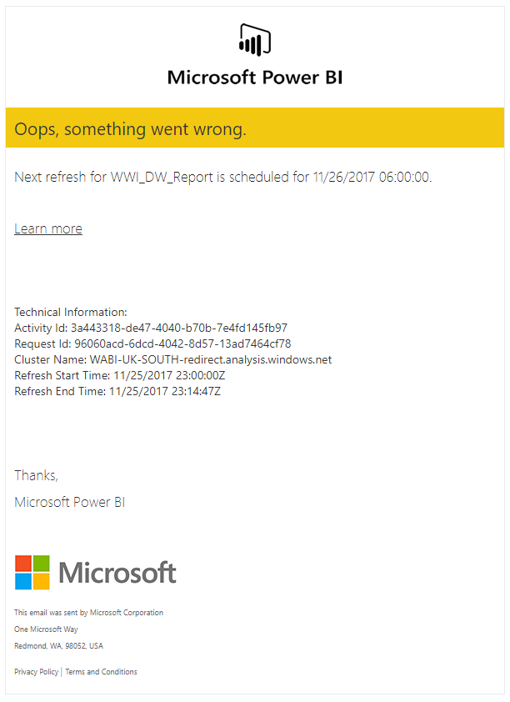
Paul Broadwith @pauby

Slide 6
Powershell alerting

Slide 7
Authentication function
Prerequisites
ADAL Module
Power BI ‘Server-Side’ App
Granting ‘App’ permissions via Azure
Your tenant ID

Slide 8
notification function
Basic & reusable
Mail Server authentication

Slide 9
Monitor script
DEMO

Slide 10
Get-PBIAuthTokenUnattended
Authenticate to Power BI
Get all Workspaces
Get all Datasets in Workspace
Get last Refresh info for dataset
Failed Scheduled Dataset Found
Force Refresh by API
Failed viaAPI Dataset Found
Send Alert Email
Set-AlertEmail

Slide 11
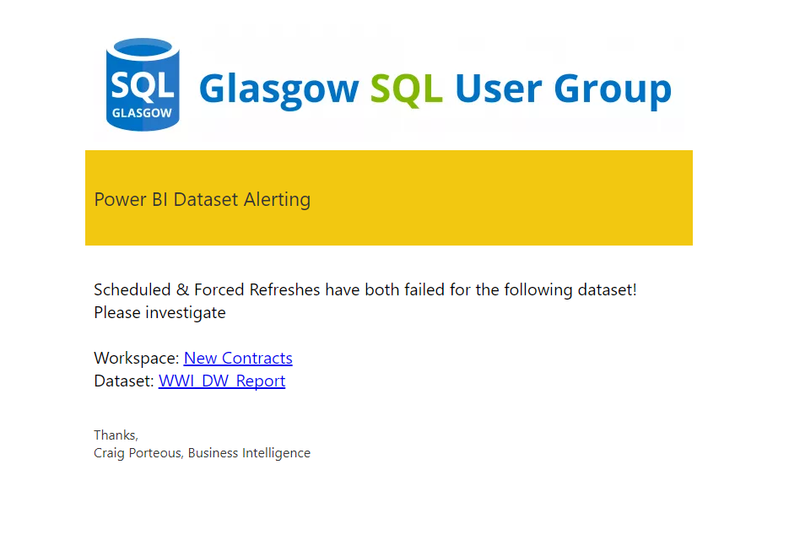

Slide 12
Beyond alerting
Inception?
QUERY Power BI Metadata with API
Store metadata in SQL
Feed back into Power BI Dashboard

Slide 13
Questions?

Slide 14
resources
My GitHub Profile - https://github.com/cporteou
Dead ‘Learn More’ Link – https://docs.microsoft.com/en-us/power-bi/refresh-tools-for-troubleshooting-issues/
Troubleshooting Refresh Scenarios - https://docs.microsoft.com/en-us/power-bi/refresh-troubleshooting-refresh-scenarios
Power BI App Registration - https://dev.powerbi.com/apps
StackOverflow TenantID command - https://stackoverflow.com/a/32636968/4624127

Slide 15



Thank you!
Paul Broadwith @pauby
Craig Porteous
@cporteous CraigPorteous.com github.com/cporteou

